Slide 1
„Between Parent and Child” Intoduction to Dr. Haim Ginott’s Congruent Communication Theory and Practice in Parent Education
GRUNDTVIG Partnership Project
„Soft Skills – Empowered Parents”
Study Group - October 2014
This project has been funded with support from the European Commission. This presentation reflects the views only of the author, and the Commission cannot be held responsible for any use which may be made of the information contained therein.

Slide 2
What is a goal of the presentation?
Reflection on historical and theoretical framework of parent education to understand basic assumption and methodology, starting with Haim Ginott (1965) and his followers Adele Mazlish & Elaine Mazlish.

Slide 3
What is a goal of the presentation?
Reflection on historical and theoretical framework of parent education to understand basic assumption and methodology, starting with Haim Ginott (1965) and his followers Adele Mazlish & Elaine Mazlish.
Comparative analisis of contemporary parent education movement in context of Emotional Inteligence and Neuroscience.

Slide 4
What do parents ask for?

Slide 5
What do parents ask for?
Usually parents ask for advice in coping with a child.
What to do and/or how to do it when something goes wrong?

Slide 6
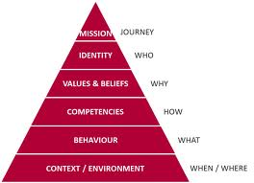
What do parents ask for?
Usually parents ask for advice in coping with a child.
What to do and/or how to do it when something goes wrong?
Logic Pyramid by Robert Dilts
WHAT FOR

Slide 7
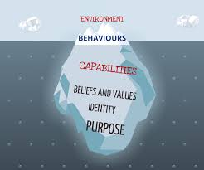
What do parents ask for?
Usually parents ask for advice in coping with a child.
What to do and/or how to do it when something goes wrong?
Logic Pyramid by Robert Dilts
Iceberg of awareness
WHAT FOR

Slide 8
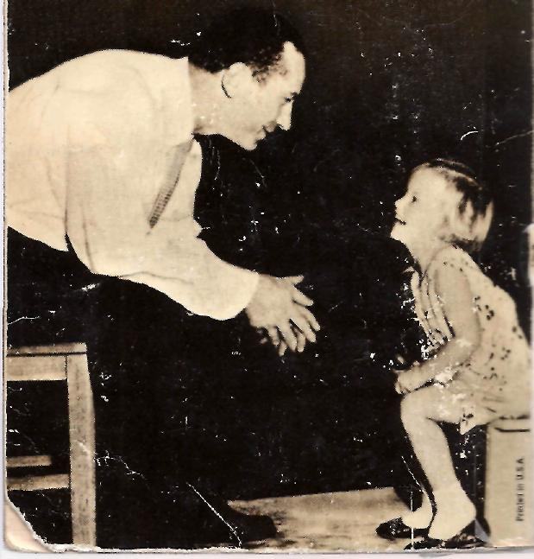
Haim G. Ginott
(originally Ginzburg)
(1922–1973) was a school teacher, a child psychologist and psychotherapist and a parent educator. He pioneered techniques for conversing with children that are still taught today.
His approach was based on Emotional Inteligence before it was called that way. (Dariusz Baran’s opinion)

Slide 9
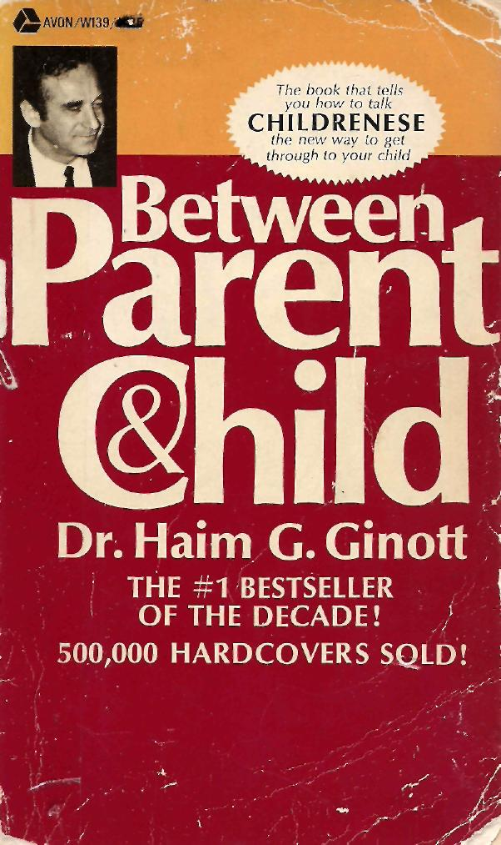
In 1965
Dr. Haim Ginott published his first book to the memory of his younger brother.

Slide 10
Interview with Haim Ginott on TV What do we want to educate children to?
Haim Ginott says: We assume that no parent wakes up in the morning planning to make a child's life miserable. No mother or father says, "Today I'll yell, nag, spank and humiliate my child whenever possible." On the contrary, in the morning many parents resolve, "This is going to be a peaceful day. No yelling, no arguing, and no fighting." Yet, in spite of good intentions, the unwanted war breaks out again. Apparently decisions are not enough.
Parents need skills to relate with children, so they become human beings with concerning, with care, one who is committed to life and all human beings.
https://www.youtube.com/watch?v=v4vgna4lj50

Slide 11
Interview with Haim Ginott on TV
To end fruitless dialogues
between parents and children
"I came into conlusion that our first response is not ours. It's our parents response. We remember it. We hear in ourselves a script that our parents wrote to us. What I am suggesting is:
"Let's write another script“
”Let's be a novelist of our own life."
https://www.youtube.com/watch?v=CAyCEgQLB1U&list=PLEB1WbrIUIWtgu__IP3-MEPxtszBTWsAZ&index=6

Slide 12
Haim Ginott called his approach as
Congruent Communication Theory

Slide 13
Why Congruent Communication Theory?
Usually parents are permisive or strict towards their children. Parents start with permisiveness and end with strictness. Then they repeat a cycle.

Slide 14
Why Congruent Communication Theory?
Usually parents are permisive or strict towards their children. Parents start with permisiveness and end with strictness. Then they repeat a cycle.
Haim Ginott promotes third way:
I am permisive to desire, feelings and wishes
I am strict to undesirable behaviour.
https://www.youtube.com/watch?v=sMo80A_AAEw&index=7&list=PLEB1WbrIUIWtgu__IP3-MEPxtszBTWsAZ

Slide 15
Congruent Communication Theory for Parents
This is a language of compassion
and language of caring.
The art of reading
the heading (emotional) meanings
of child’s words and behaviours.
https://www.youtube.com/watch?v=csj04h3zpFo&list=PLEB1WbrIUIWtgu__IP3-MEPxtszBTWsAZ

Slide 16
CHILDREN'S QUESTIONS: THE HIDDEN MEANINGS
On his first visit to kindergarten, while moth­er was still with him, Bruce, age five, looked over the paintings on the wall and asked loudly, "Who made these ugly pictures?"
Mother was embarrassed. She looked at her son disapprovingly, and hastened to tell him, "It's not nice to call the pictures ugly when they are so pretty."
The teacher, who understood the meaning of the question, smiled and said, 'In here you don't have to paint pretty pictures. You can paint mean pictures if you feel like it." A big smile appeared on Bruce's face, for now he had the answer to his hidden question: "What happens to a boy who doesn't paint so well?"

Slide 17
CHILDREN'S QUESTIONS: THE HIDDEN MEANINGS
Next Bruce picked up a broken fire engine and asked self-righteously, "Who broke this fire engine?" Mother answered, "What difference does it make to you who broke it? You don't know anyone here."
What was the hidden meaning of child’s question?

Slide 18
CHILDREN'S QUESTIONS: THE HIDDEN MEANINGS
Bruce was not really interested in names. He wanted to find out what happened to boys who break toys. Understanding the question, the teacher gave an appropriate answer: "Toys are for playing. Sometimes they get broken. It happens”.
Bruce seemed satisfied. His interviewing skill had netted him the necessary information:
"This grownup is pretty nice. She does not get angry quickly, even when a picture comes out ugly or a toy is broken: I don't have to be afraid. It is safe to stay here." Bruce waved good-by to his mother and went over to the teacher to start his first day in kindergarten.

Slide 19
THE NEW CODE OF COMMUNICATION (in sixties XX centuary)
The new code of communication with children is based on respect and on skill. It requires:
that messages preserve the child's as well as the parent's self-respect;
that statements of understanding precede statements of advice or instruction.
https://www.youtube.com/watch?v=a1OkD6jYq3k&index=10&list=PLEB1WbrIUIWtgu__IP3-MEPxtszBTWsAZ

Slide 20
OLD STYLE OF COMMUNICATION
Eric, age nine, came home full of anger. His class was scheduled to go for a picnic, but it was raining. Mother used to say in the past:
"There is no use crying over rained-out picnics."
"There will be other days for fun."
"I didn't make it rain, you know, so why are you angry at me?"
Could you help mother to say it in respectful and skillful way?

Slide 21
Mother’s respectful and skillful way of talking with Eric
To herself mother said, "My son has strong feelings about missing the picnic. He is disappointed He is sharing his disappointment with me by showing me his anger. He is entitled to his emotions. I can best help him by showing understanding and respect for his feelings." To Eric she said:
mother: You seem very disappointed.
ERic: Yes.
mother: You wanted very much to go to this picnic.
eric: I sure did.
mother: You had everything ready and then the darn rain came.
eric: Yes, that's exactly right.
There was a moment of silence and then Eric said, "Oh, well, there will be other days.„ His anger seemed to have vanished and he was quite cooperative the rest of the afternoon.

Slide 22
What was so special about Haim Ginott’s approach in the sixties of XX centuary?
When a child is in the midst of strong emotions, he cannot listen to anyone. He cannot accept advice or consolation or constructive criticism. He wants us to understand him. He wants us to understand what is going on inside himself at that particular moment. Furthermore, he wants to be understood without having to disclose fully what he is experiencing. It is a game in which he reveals only a little of what he feels needing to have us guess the rest.
What does it remind us in XXI centuary?

Slide 23
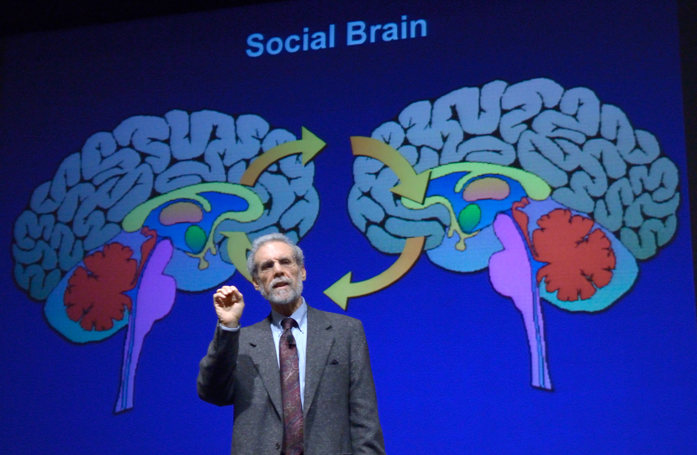
Daniel Goleman’s story about AMYGDALA and EMOTIONAL INTELIGENCE
https://www.youtube.com/watch?v=LTItzKrNX68

Slide 24
Haim Ginott’s approach in context of Neuroscience
Parent’s mind (prefrontal cortext integrated with limbic system) is connected to child’s mind and makes her/his amygdala calmed down and self-awareness (PFC) developed.
„Child’s mind is always in parent’s mind”

Slide 25
Fish swim

Slide 26
Birds fly

Slide 27
People feel

Slide 28
People love

